Slide 1
INTELLIGENT DEBUGGING EVALUATOR WITH ADAPTIVE TEST ALGORITHM
Student Names
1.JEWEL JAMES (B.E-CSE)
(311011104036)
2.JEFFIN BEN (B.E-CSE)
(311011104035)
Project Guide
Mrs. DHANYA ANAND. M.E
Assistant Professor

Slide 2
OBJECTIVE
1. To develop a standard tool for evaluating skill of programmer in debugging.
2. To meet the emerging need for such a tool in conducting technical events and online exams.
3. To help students to develop their own programming skills by doing a self test.
4. To help the software firms to test the programming level of trainees during their training period.

Slide 3
ABSTRACT
1) The online Debugging Evaluator is a web service.
2) It can compile C and C++ programs in the web browser.
3) This is also an online evaluator tool that is capable of evaluating the marks secured from the debugging test and display the result in the web browser itself.
4) This algorithm segregates the available programs in the database in to Easy, Hard and Medium based on the no. of errors, no. of characters, no. of functions used, no. of loops used, no. of variables used and no. of statements used.

Slide 4
MOTIVATION
The main purposes of the project are mentioned below
1)There are so many symposiums and technical events conducted in various engineering colleges which require an online debugging evaluator
2)In software companies also there is a huge opportunity for online debugging system for trainees.
3)So to meet the technical needs of so many software firms and engineering colleges, we are trying to develop this online software tool.
Hence this project module will be a Corporate or university level
Training tool for programmers.

Slide 5
LITERATURE SURVEY
A Web Registry for Publishing and Discovering Mathematical Services Rebhi Baraka, Olga Caprotti, and Wolfgang Schreiner Research Institute for Symbolic Computation (RISC-Linz) Johannes Kepler University, Linz, Austria
The existing Systems that are available for online debugging are also websites. These websites are capable of only executing a string comparator mechanism. This mechanism is not effective when the system results of the debugging are considered. Few best examples of online compiler available are:-
COMPILEONLINE.COM
IDEONE.COM
W3SCHOOLS.COM

Slide 6
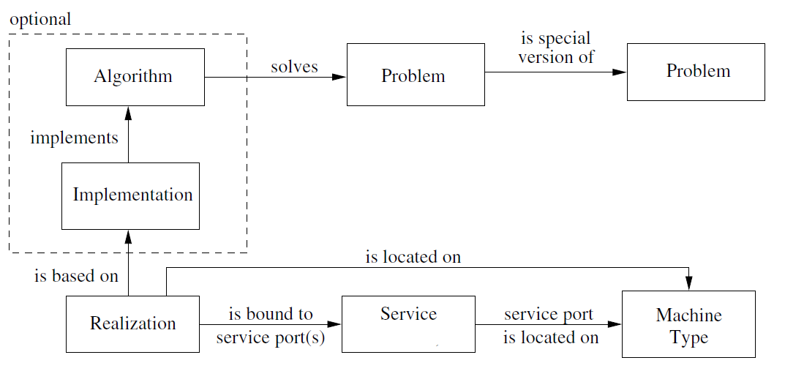
Base Paper Architecture

Slide 7
Proactive and Reactive Runtime Service Discovery: A Framework and Its Evaluation Andrea Zisman, George Spanoudakis, Member, IEEE,James Dooley, Member, IEEE, and Igor Siveroni
The Push Mode Algorithm. This algorithm is used to Proactively discover a Web Service using the Discovery Module simultaneously during the run time of the web service.
A proactive web service discovery module that will simultaneously run the discovery and shows all the related web service during run time.
no proper linking between proactive and reactive discovery

Slide 8
PROBLEM DEFINITION
These Online compilers are only a compiler system and they do not have an online evaluating system.
These Online compilers are only a compiler system and they do not have an online evaluating system. And these online compilers lack the following features
1.A dedicated Evaluator
2. Adaptive test algorithm
3. results are not accurate

Slide 9
PROPOSED SOLUTION
The proposed INTELLIGENT DEBUGGING EVALUATOR contains the following modules
1. Online Compiler,
2. Online Examination Module
3. Online Evaluator with Mark sheet.
This system also has higher end features which will increase the effectiveness of the test module and then increase the efficiency of the programmers. These features are
1. Adaptive Test Algorithm
2. Random Function

Slide 10
COMPARISON BETWEEN AND EXISTING AND PROPOSED SYSTEM
EXISTING SYSTEM: | It only has an online compiler | It uses push and pull mode algorithms alternatively. | Both modules are not available together.
PROPOSED SYSTEM: | It has an online compiler with a evaluator system with mark sheet and an adaptive test algorithm | It uses only Push mode algorithm for proactive web service discovery. | Online Debugging Evaluator is available with a web service discovery module.

Slide 11
REQUIREMENT ANALYSIS
PROJECT REQUIREMENTS:
Pentium 4 1.7Ghz Processor with 256mb RAM.
Windows XP
Xamp local host server
LAN network or WiFi
TECHNOLOGIES USED:
PHP
JAVASCRIPT
HTML
C++
Xamp

Slide 12
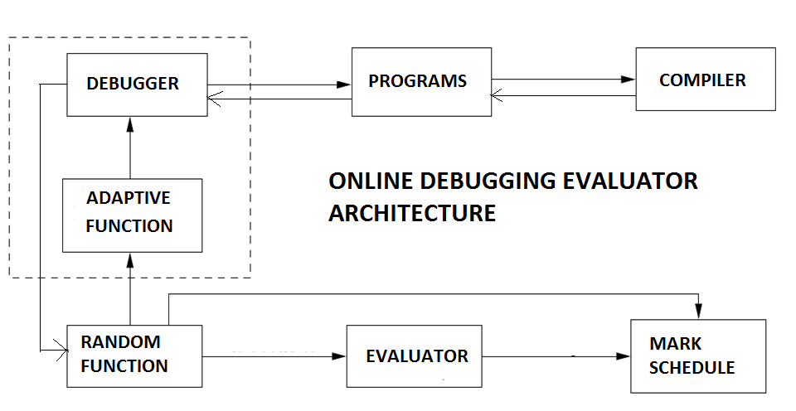
MODULE EXPLANATON

Slide 13
The Major Design Modules available are:-
1) web page design
2) Compiler – Turbo C
3) Debugger - compile the programs and detect the number of errors available
4) Evaluator - calculates the marks scored by the participant
5) Program - programs that are needed for compilation are arranged based on parameters
6) Adaptive Function - categorize the programs as per the user and then changes the programs in run time based on the user performance in the previous tests
7) Random Function – provide random order

Slide 14
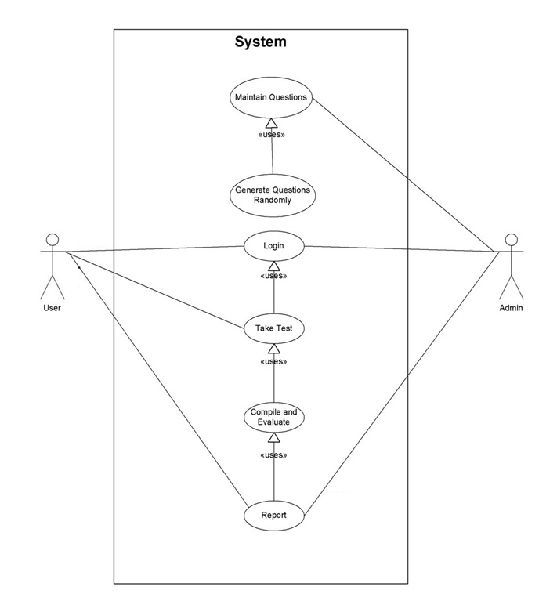
Use Case Diagram

Slide 15
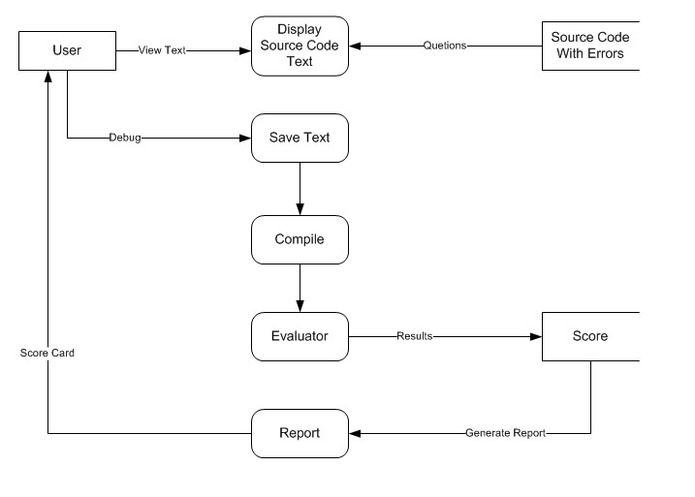
Data Flow Diagram

Slide 16
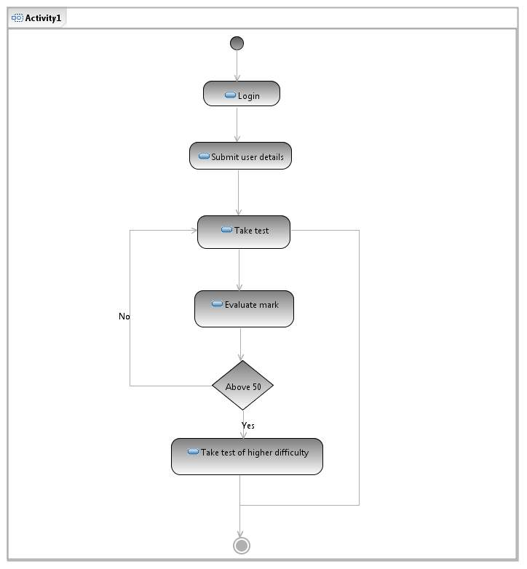
Activity Diagram

Slide 17
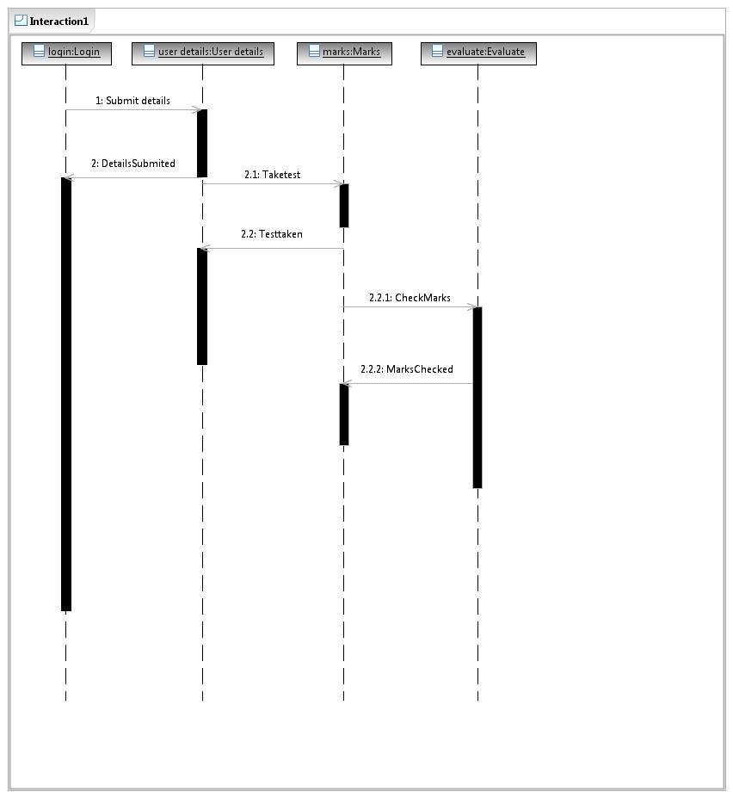
Sequence Diagram

Slide 18
Adaptive Test Algorithm
Step 1: The user input for Beginner, intermediate and expert is taken in a drop down menu.
Step 2: The conditions for sorting the programs based on the user criteria is taken.
Step 3: Now all the programs available for the test module is compiled once and made ready for adaptive function.
Step 4: The programs are categorized based on their number of lines, no of errors, and the number of functions, loops, variables, pointers, arrays and header files used.
Step 5: Now the Adaptive function will separate the programs based on these criteria and then the programs will b segregated into EASY, MEDIUM and HARD Destinations.

Slide 19
Pg Weigt. =( ( no. of Fn * 3) + (no. of loops * 2) + (no. of ptr * 1) + (no. of arr * 1)+(no. of var*0.5))/5
Total weight = No. of errors + no. of lines + pg Weight
Step 6: Now the test module will send one normal level program.
Step 7: Based on the user’s performance in the previous programs the adaptive function will decide whether to send easy program or hard program.

Slide 20
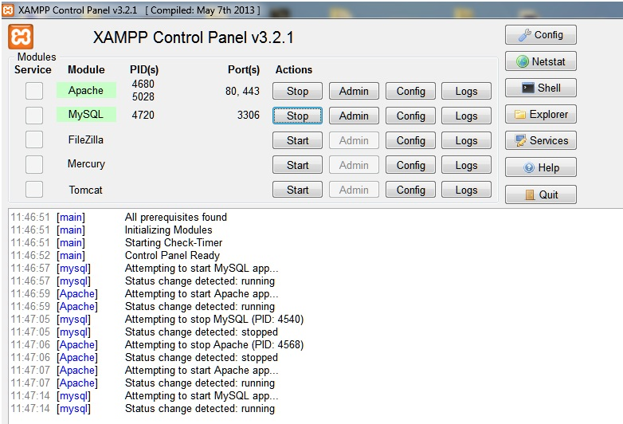
Screen Shots- Xamp Control Panel

Slide 21
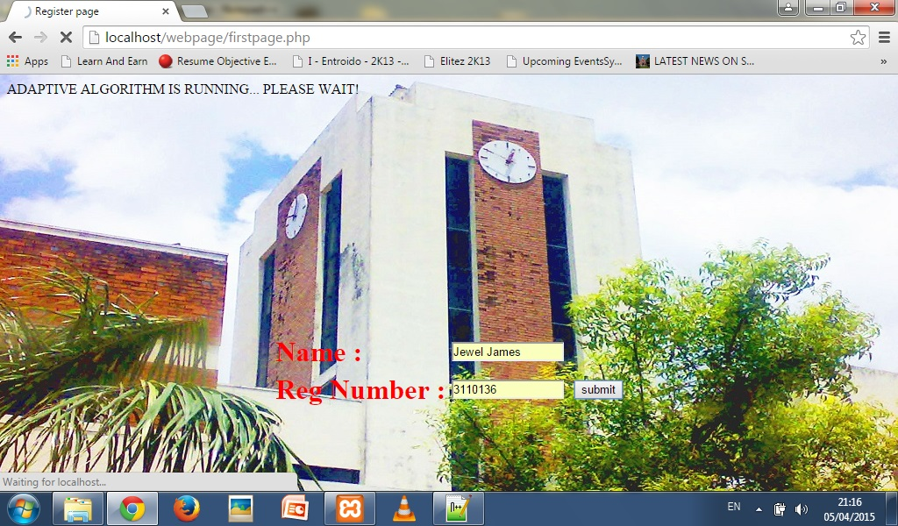
Screen Shots- Login

Slide 22
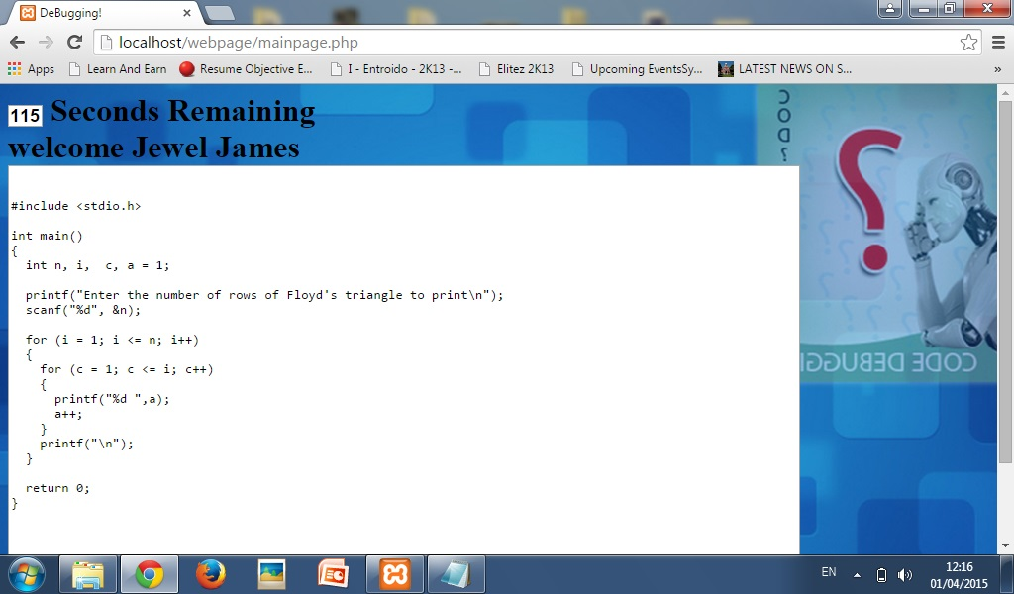
Screen Shots – Test page1

Slide 23
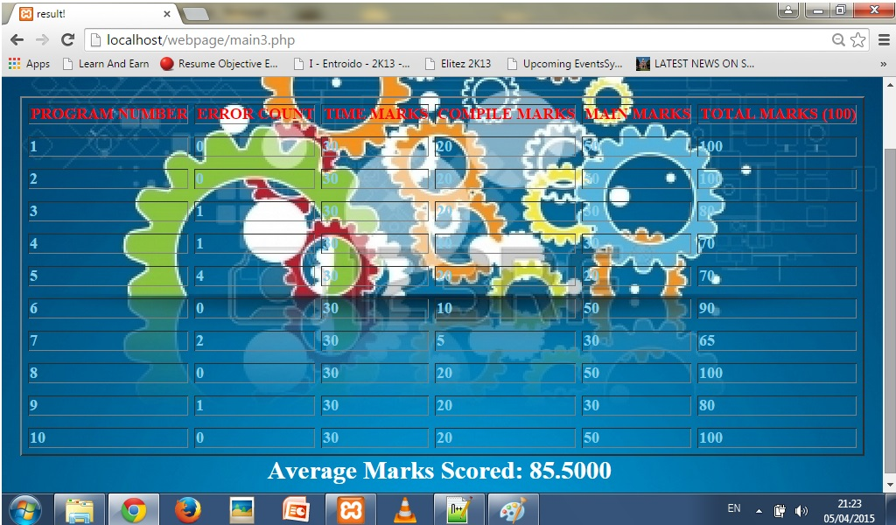
Screen Shots- Report page

Slide 24
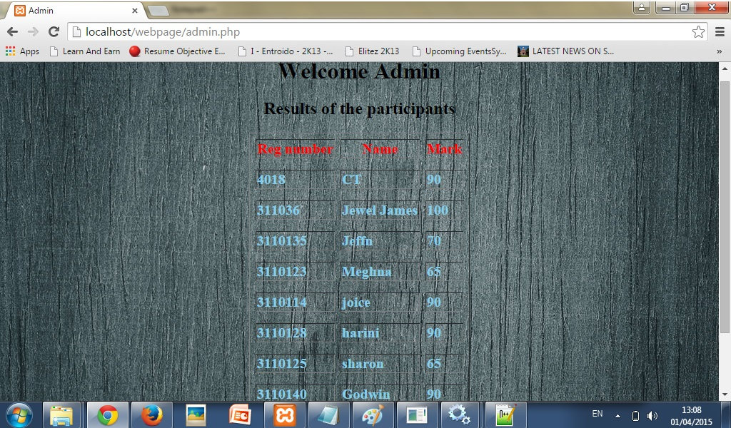
Screen Shots- Result of the participants

Slide 25

Screen shot- Final Report Page

Slide 26
Conclusion
To meet the technical needs of so many software firms and engineering colleges, this website can be improved with the capacity to improve more programming languages.
It also helps the students to know his own ability in the field of programming skills.
The newly designed system is only a prototype of online debugging system.
The algorithm has to be improved and the number of programming languages available for debugging should also be improved to make this system more effective.

Slide 27
REFERENCES:
Armen C., and Morelli, R. (2005) ‘Computer science: Teaching about the risk of electronic technology’, ACM ITiCSE.
Andrea Zisman, George Spanoudakis, James Dooley and Igor Siveroni. (2009) ‘Proactive and reactive Runtime Service Discovery: A Framework and its Evaluation’, IEEE.
Mahbub, K., Spanoudakis, G. and Zisman, A. (2011) ‘Runtime service discovery’, Automated Software Engineering.
May Chan, K.S. (2011) ‘Self-healing cycle for web service composition’.
Rebhi Baraka∗, Olga Caprotti, and Wolfgang Schreiner,(2014) ' A Web Registry for Publishing and Discovering Mathematical Services’.
Sheng, Q.Z., Benatallah, B., Maamar, Z. and Ngu, A.H.H. (2007) ‘Configurable composition and adaptive provisioning of web services’, IEEE.
Stallings W. (2003) ‘Network security, principles and practice’, Third edition, pp.67-68 and 317-375, Prentice Hall.

